Slide 1
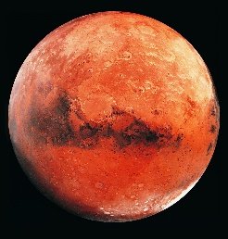
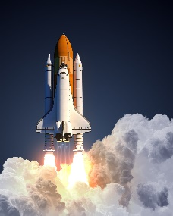
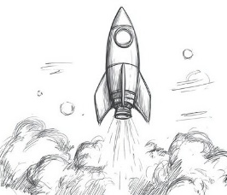


Physics Competition
As part of your new Brain Builder, we are thrilled to announce an exciting opportunity for you to engage with the thrilling world of STEM through a special physics competition! You will need to design a poster for a rocket which is capable of safely landing on the fascinating surface of Mars. This is not only a chance for you to explore the principles of physics but also to unleash your creativity and innovation.
We would like you to include detailed sketches and descriptions of your rocket design, highlighting the scientific concepts you have considered. If you wish to create a model rocket, you are also allowed to do this. However, this is optional as a poster entry is more than sufficient!
All designs and any accompanying models need to be handed in on Friday 16th May. We are looking forward to seeing the imaginative solutions you create for this interplanetary challenge!
The excitement doesn’t end there! The winning designs will be rewarded with a prize!
Happy designing! Brain Builder Due Date: Friday 16th May

